Slide 1
Homeless Shelter Optimization to Allocate New Shelters
Heidi Al Wakeel, Adityo Das Gupta, Tyler Nagano, Tarek Cheaito, Mohamad Dalati
Team 1:
MGSC 662: Decision Analytics

Slide 2
Agenda
Introduction and Project Description
Data Collection
Data Preparation
Modelling
Maximize Homeless to Current Shelters
Minimize Cost of New Shelters
Important Insights

Slide 3
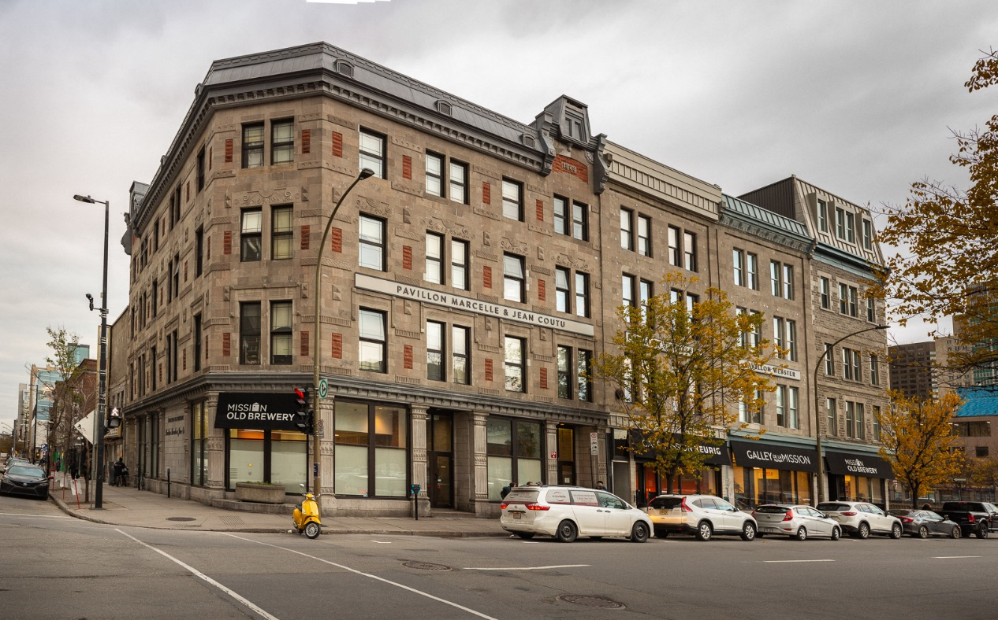
What is the Problem?
In 2018, total homeless population in Montreal was 3149 people
Homelessness has increased by 20% in 2020 due to COVID-19
Capacity of current homeless shelters cannot support demand
Goal of our project is to determine best location for new homeless shelters to account for demand
Reduce homelessness in Montreal
Old Brewery Mission – Homeless Shelter in Montreal
Notes:
Growing problem
Homelessness is a growing problem in Montreal
Puts people in unstable conditions and poverty
Homeless hub statistics
James Hughes, CEO of Old Brewery Mission homeslessness has increased by 20%
Capacity cannot support demand and mismanaged
Goal to determine best location on Montreal island to allocate new shelter
Important because we will reduce the homelessness leading to improved quality of life

Slide 4
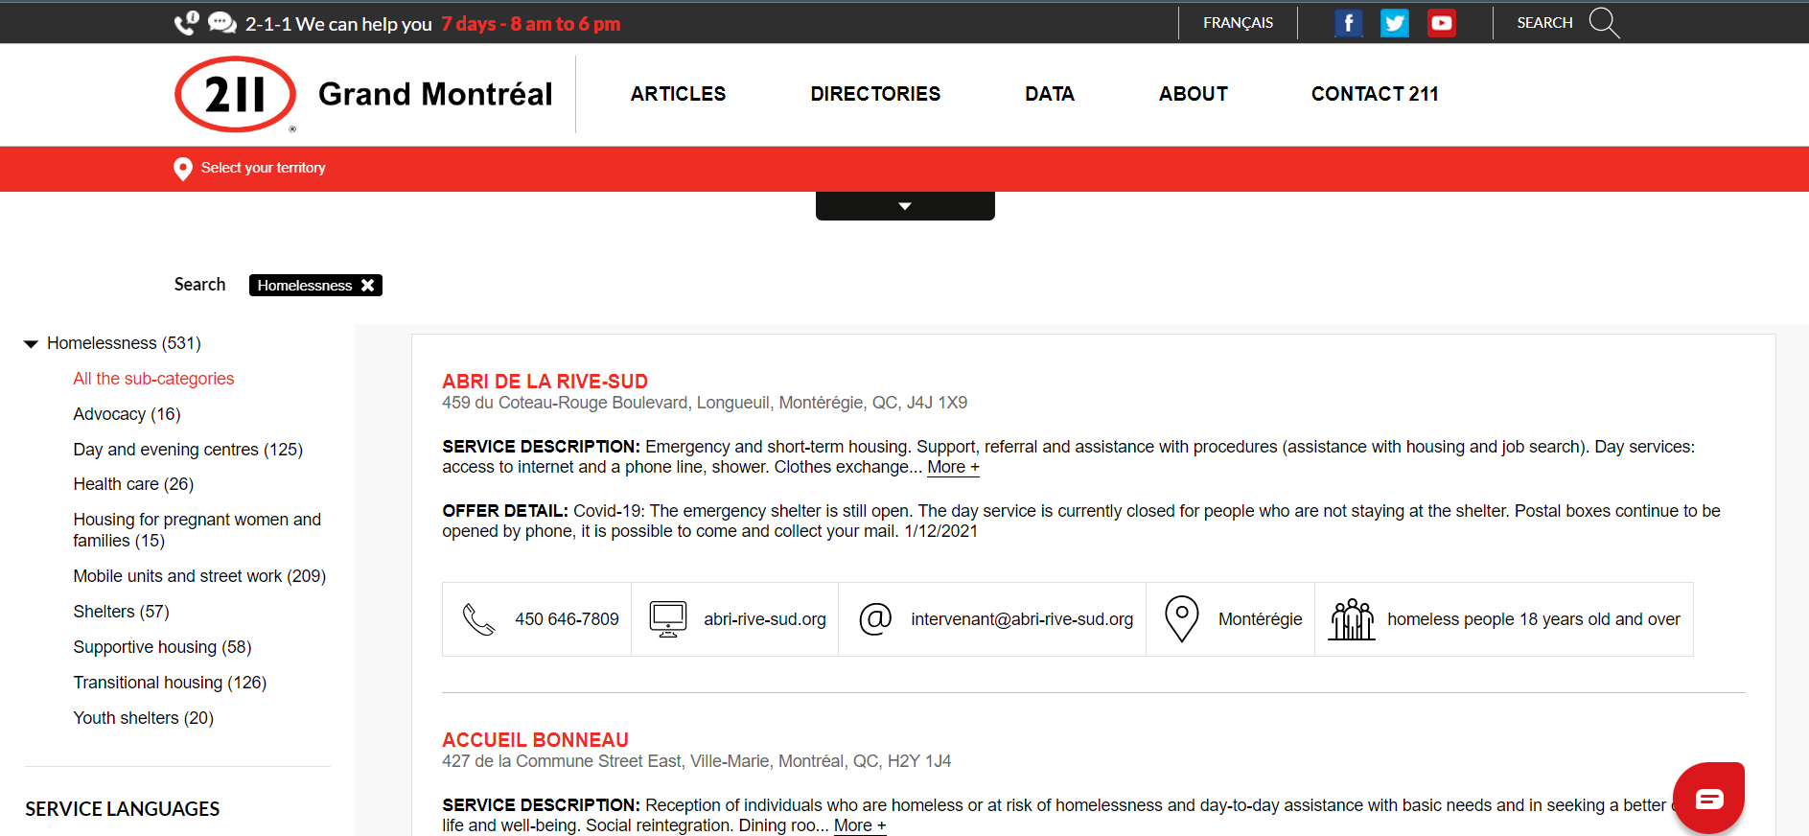
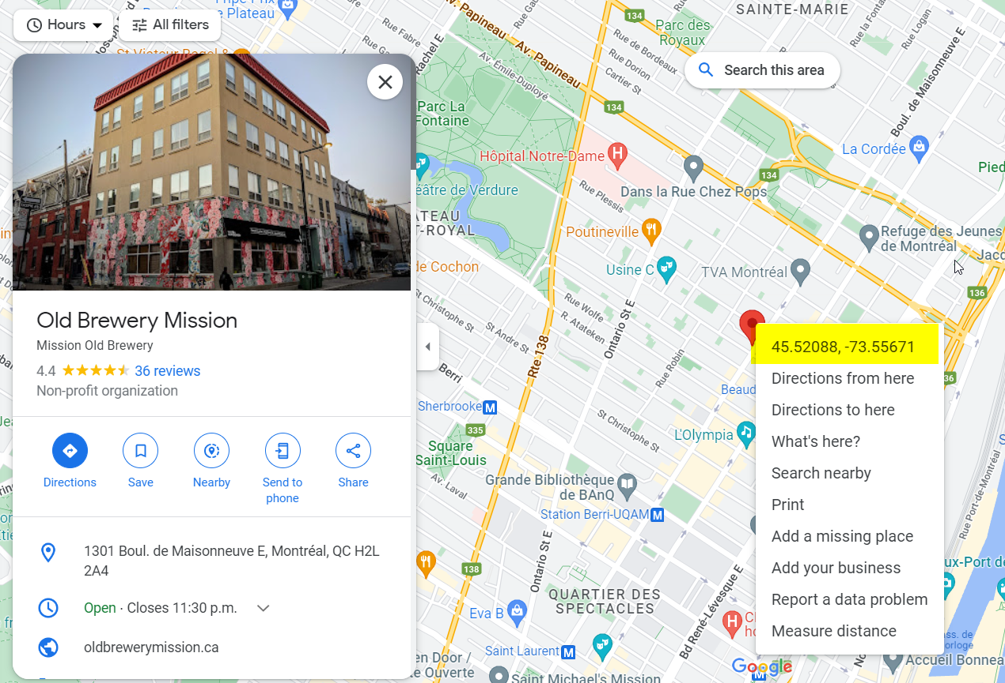
Data Collection
Current Capacity of Homeless Shelters on Montreal Island
Homeless Population (Hot Spots)
Homeless Encampments
Metro Stations
New Shelter Locations
Latitude and Longitude from Google Maps
Total Expenses from Financial Statements
Notes:
Collect data on current homeless shelters, new potential homesless shelters and locations of current homeless people
- emergency/transitional collected from 211qc.ca
Capacity found on each individual website
Homesless population homeless encampments from news websites and assumption that homeless would be near metro stations
New potential shelter locations
Latitude and longitude from google maps for all locations
- Expenses collected from online financial statements

Slide 5
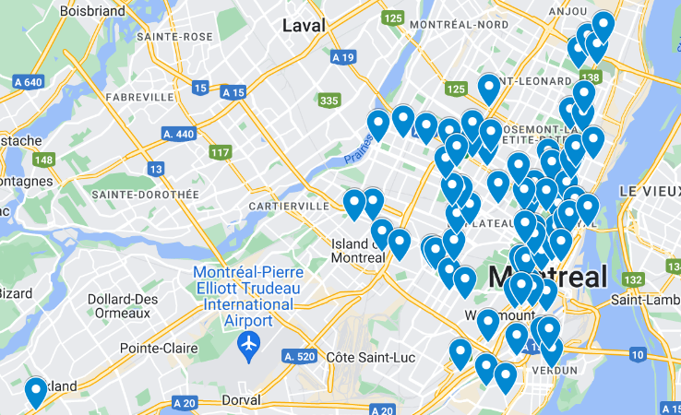
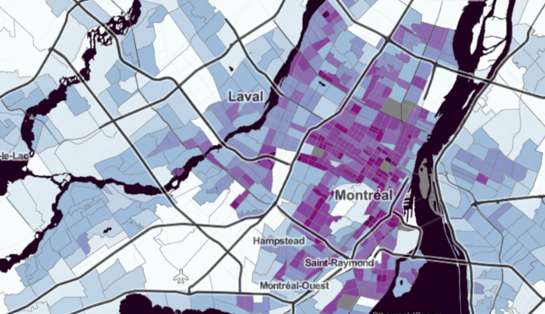
Data Preparation
Distributed homeless population 50/50 metro stations and encampments
Encampments equally allocated except West Island
Metro Stations used closest census tract population per square km
Scale: Location density / min(density)
Total * scale / sum(all scale)
For each metro station
Notes:
List assumptions
Homesless population distribution 50/50
70% male vs 30% female
Assumption that most homeless will be around metro stations
Encampments equally allocated
Assumption Metro stations that population density around metro station will be similar to homeless population density

Slide 6
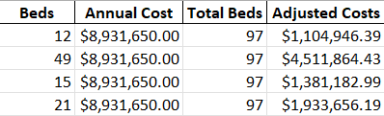
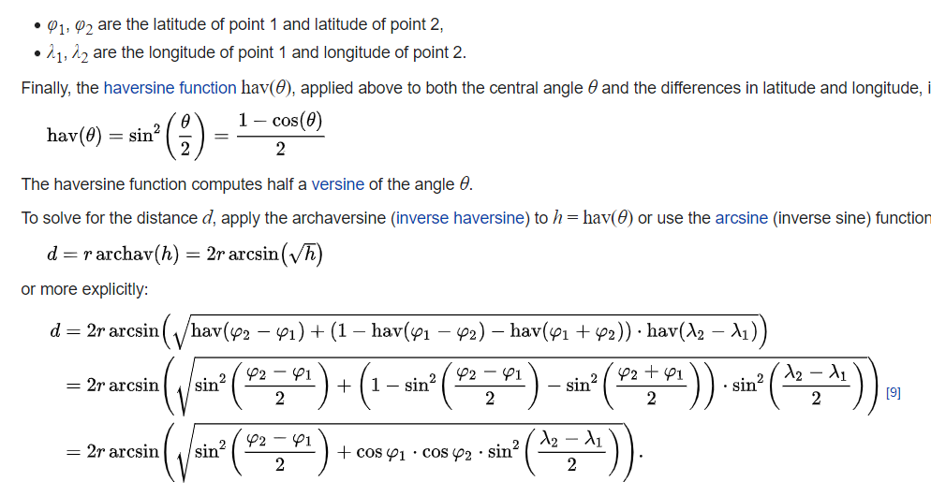
Data Preparation
Total Expenses Adjustments
Multiple Locations
Missing Values
New Shelter
Cost per Homeless
Fixed Cost
Haversine Distance
Calculates angular distance along a sphere based on latitude and longitude
Between hot spots to new and existing shelters
Notes:
Multiple Locations sum capacity at all and take capacity of one / other
Missing values were replaced by median expenses of all current shelters
New shelter cost based on mean of 3 closest shelters
Haversine Distance
Calculates distance between two latitude and longitude coordinates
Between metro stations and encampments to existing and new potential shelters

Slide 7
Model Development
The project was split into two phases
Maximise the homeless people from their existing locations into the homeless shelters
Minimize the cost of housing the unallocated homeless population from each hotspot (encampment/metro station)
Notes:
So we divided the project into two phases.
-The first phase dealt with maximising the homeless individuals from the streets into the shelters .
- This was more of a simulation than optimization since there is an element of randomness in how the individuals go to a shelter,
-Thus the goal was to obtain the number of individuals who remain unallocated at the end of this process.
-Once we had this number, the second phase was concerned with opening new locations to house the unallocated population at minimum cost

Slide 8
Model 1 – Maximising Occupancy
Decision Variables :
𝑥_{𝑖,𝑗,𝑘} : homeless people allocated from hotspot i to shelter j for gender k {0 = female, 1 = male} (Integer)
Parameters :
B_{j} : Bed capacity of shelter j
F_{i} : Number of Females in hotspot i
M_{i}: Number of Males in hotspot i
s : Total number of existing shelters
h : Total number of hotspot locations
F_{i}: Number of Females in hotspot i
M_{i}: Number of Males in hotspot i
𝑑_{𝑖,𝑗} : 𝑇ℎ𝑒 𝐻𝑎𝑣𝑒𝑟𝑠𝑖𝑛𝑒 𝑑𝑖𝑠𝑡𝑎𝑛𝑐𝑒 𝑏𝑒𝑡𝑤𝑒𝑒𝑛 ℎ𝑜𝑡𝑠𝑝𝑜𝑡 𝑖 𝑎𝑛𝑑 𝑠ℎ𝑒𝑙𝑡𝑒𝑟 𝑗
Notes:
As you can see our decision variable is the number of people moving from one hotspot to a shelter wrt to the gender and our parameters are concerned with the capacities of shelters, distribution of homeless across the city and the distance between each combination

Slide 9
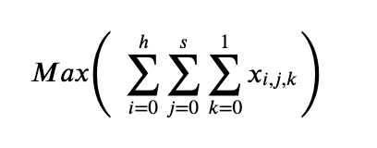
Model 1 – Objective Function
We try to maximise the number of people moving from their respective hotspots to the shelters
Notes:
Our objective function tries to maximise the ….

Slide 10
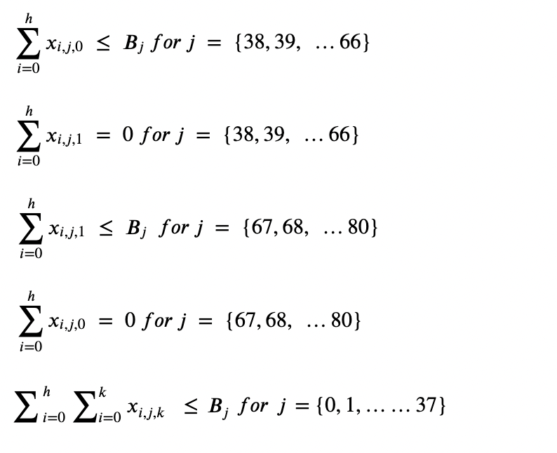
Model 1 - Constraints
Female only shelters can house only females
Male only shelters can house only males
Open shelters can house anyone
A shelter can house no more people than its capacity
Notes:
Moving on to our constraints, female can go to female , male to male, open to all , and no shelter can house more than its capacity

Slide 11
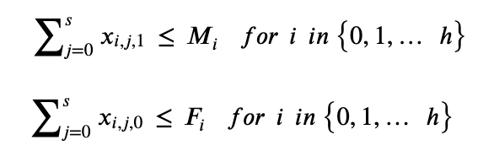
Model 1 - Constraints
A hotspot can't have more people than the assumed distribution
Notes:
Hotspots can't have more people than what is allocated to them

Slide 12

Model 1 - Constraints
An individual can't travel more than 4 kilometers
Non-negativity constraints
Notes:
We also assumed that no individual can walk more than 4km

Slide 13
Model 1 - Results
Out of the total homeless population of 3566, 3142 people were allocated to different housing shelters with the following locations having unallocated individuals,
Station | Latitude | Longitude | Homeless | Remaining
Plamondon | 45.50484 | -73.6379 | 27 | 19
Cote-Sainte-Catherine | 45.50436 | -73.6349 | 67 | 67
Snowdon | 45.49569 | -73.6266 | 21 | 21
Villa-Maria | 45.49184 | -73.617 | 29 | 11
Sherbrooke | 45.52889 | -73.569 | 35 | 1
Jarry | 45.5539 | -73.6266 | 44 | 41
Cremazie | 45.55631 | -73.6404 | 29 | 20
Cote-des-Neiges | 45.50821 | -73.6239 | 29 | 20
Universite-de-Montreal | 45.51927 | -73.6218 | 27 | 19
Edouard-Montpetit | 45.52312 | -73.6143 | 32 | 22
Outremont | 45.52986 | -73.6191 | 23 | 16
Acadie | 45.5313 | -73.6246 | 17 | 17
Parc | 45.54236 | -73.6287 | 33 | 23
De Castelnau | 45.54717 | -73.6218 | 33 | 33
Notre Dame De Grace | 45.461922 | -73.620111 | 195 | 95
424 individuals unallocated
Notes:
After running the model we found out that 3142 individuals were allocated with 424 still on the streets at the following locations. Now these number will be utilized in our next model to obtain the min cost

Slide 14
Model 2 – Minimising Cost
Decision Variables :
𝑥_{𝑖,𝑗} : homeless people allocated from hotspot i to potential shelter j (Integer)
D_{i} : dummy variable corresponding to the potential shelters (Binary)
Parameters :
B_{j}: Bed capacity of potential shelter j α: Desired allocation percentage
R_{i} : Number of homeless at hotspot i
FC_{j}: Annual fixed cost of potential shelter j
HC_{j}: Cost per bed or to maintain a bed, constant throughout all potential shelters j
hl: Number of hotspot locations with unallocated people (14 locations)
ps: Number of potential shelters identified (7 locations)
di,j: The Haversine distance between hotspot i and potential shelter j
M: Big M variable = 1000000
Notes:
We assumed the potential locations will be unisex for the sake of simplicity hence there is no gender constraints and Di is a binary variable indicating if that location was used or not

Slide 15
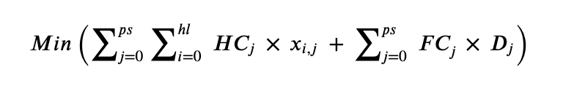
Model 2 – Objective Function
We try to minimize the cost of housing the unallocated people at the remaining hotspots
Notes:
HC is the cost of housing one homeless individual for the year hence it varies with the no of people coming in while FC the fixed cost of setting up a shelter stays constant with each shelter built

Slide 16
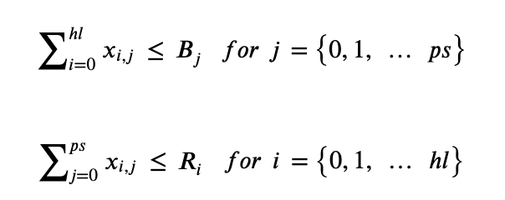
Model 2 - Constraints
The potential shelters can't accommodate more people than their capacity
The hotspots can't have more people than the unallocated
Notes:
Similar to model 1 we have the capacity constraints

Slide 17




Model 2 - Constraints
An individual can't travel more than 4 kilometers
At least α % people need to be allocated
Potential Shelter can only accommodate people if chosen
Notes:
We have distance and alpha here denotes the min % of people who need to be allocated. This was needed since it’s a minimization problem and without this the model would optimize building nothing at zero costs

Slide 18
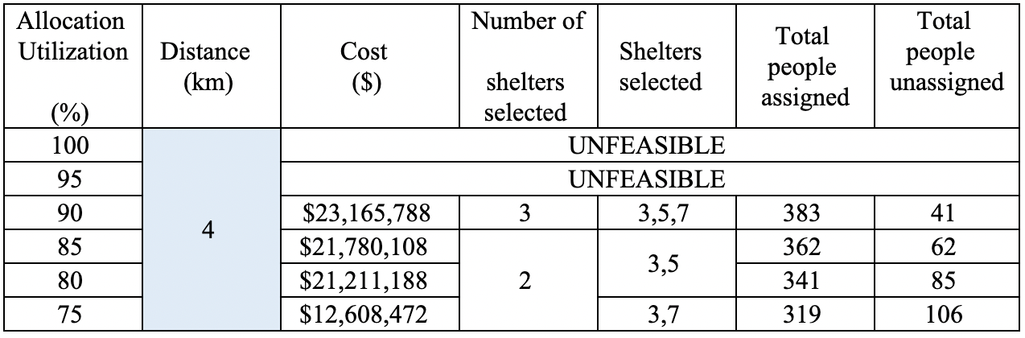
Model 2 - Results
There was a tradeoff between the minimum percentage of people to be allocated and the least distance an individual can travel.
(3: Stade de Soccer de Montreal, 5: Old Royal Victoria's Hospital, 7 : Hotel Dieu)

Slide 19
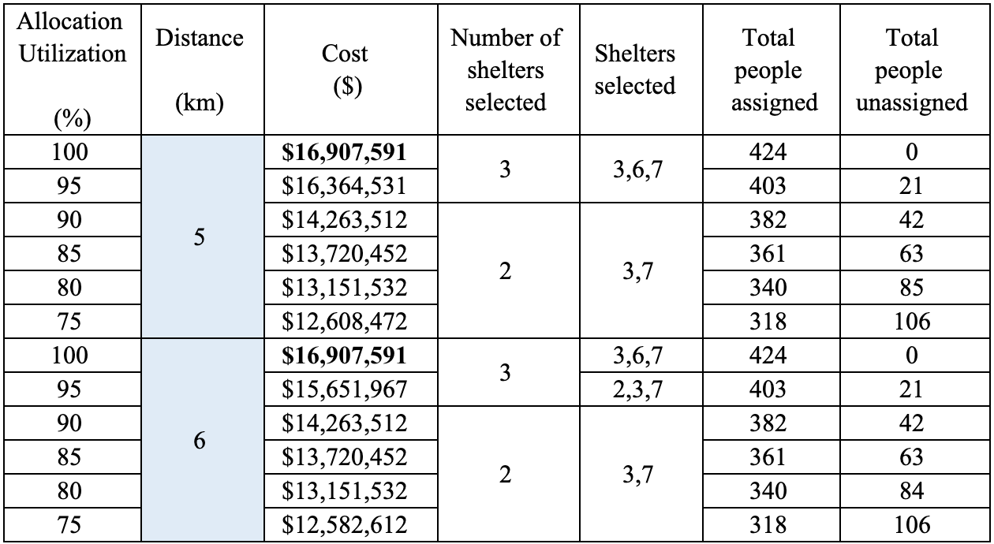
Model 2 - Extension

Slide 20
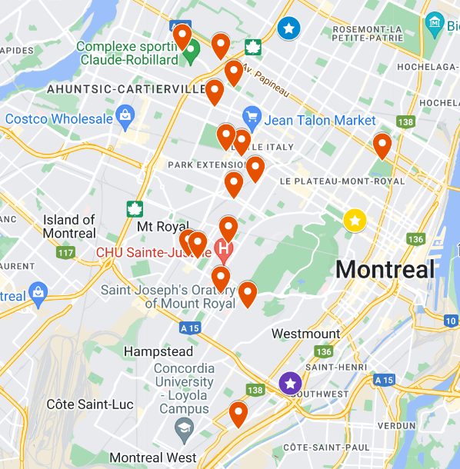
Important Insights
Based on our models unallocated homeless people are mostly located around the Blue metro line
Unallocated: Orange
New Locations (80/85%):
Stade de Soccer de Montreal (Blue)
Old Royal Victoria's Hospital (Purple)
New Locations (75%):
Stade de Soccer de Montreal (Blue)
Hotel Dieu (Yellow)

Slide 21
Concluding Remarks
Our research has introduced an optimization method to simulate homeless distribution and systematically assign unallocated homeless people to new shelter locations
This has the potential to improve outcomes for the homeless individuals
These results can be expanded upon and presented to the municipal and provincial governments of Quebec to gain funding for the creation of new shelters

Slide 22
Thank you for listening! Any Questions?

